Slide 1


PART TWO
Results & Evaluation
I led model evaluation and the cross-dataset comparison: two protocols, four classifiers, statistical significance testing, and Apriori review.

Slide 2
My Role & Evaluation
/ ROLE & PROTOCOLS
As the evaluation lead, I applied the same evaluation design to every classifier so the results are comparable and reproducible.
2 Protocols
6 Metrics
Leakage Check
4 Classifiers
10-fold stratified cross-validation and an independent 66%/34% split, seed fixed to 1.
Accuracy, precision, recall, F1-score, ROC-AUC and Kappa; rules use support, confidence and lift.
Data-driven preprocessing is fitted inside each fold, consistent with the modeling pipeline.
J48, RandomForest, Logistic and SMO evaluated on Mushroom and Ionosphere.

Slide 3
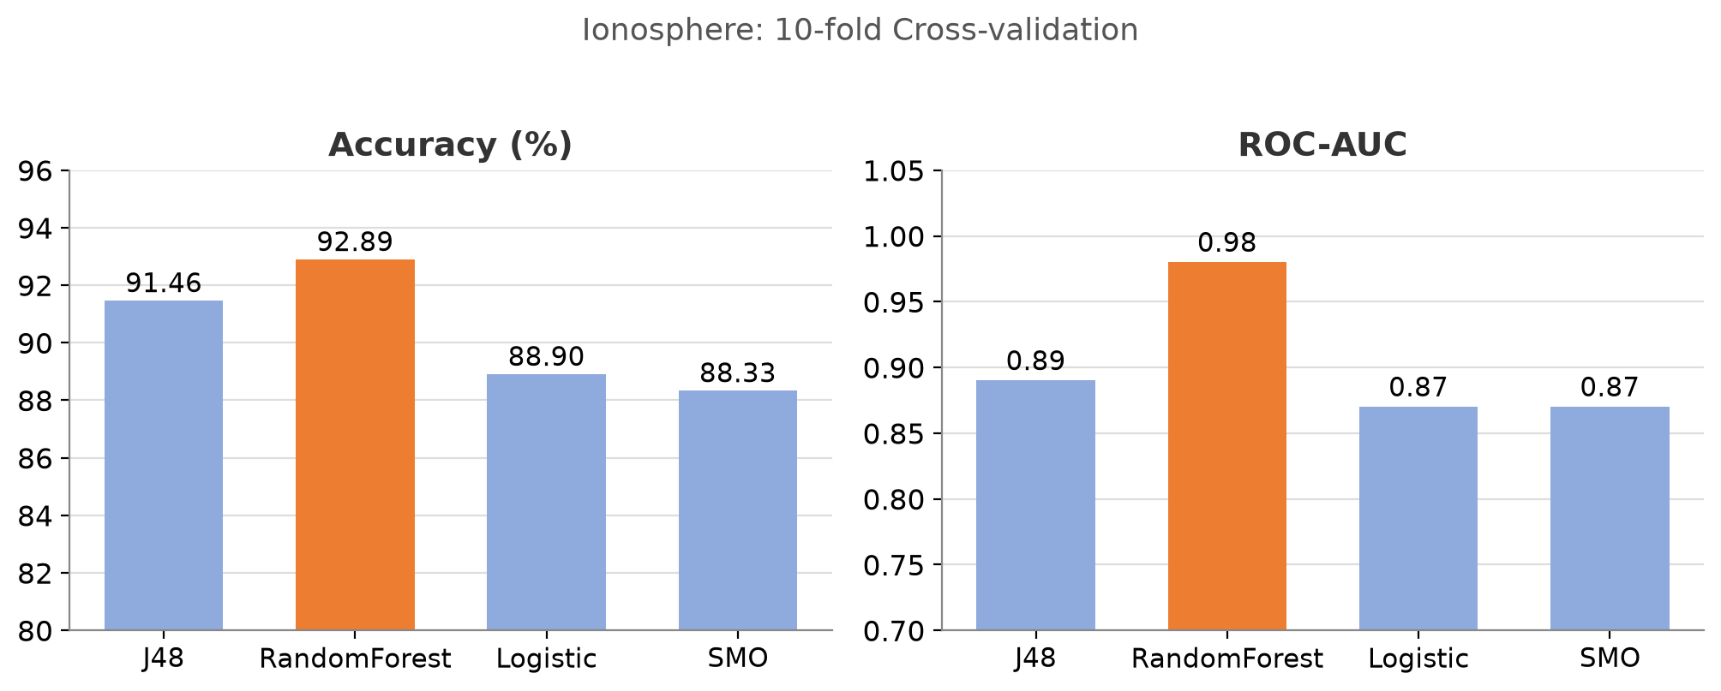
Quantitative Results
/ 10-FOLD CROSS-VALIDATION
Model | Mushroom Acc (%) | Ionosphere Acc (%) | Ionosphere AUC
J48 | 100.00 | 91.45 | 0.89
RandomForest | 100.00 | 92.88 | 0.98
Logistic | 100.00 | 88.89 | 0.87
SMO | 100.00 | 88.32 | 0.87
Best | All tie | RandomForest | RandomForest
RandomForest leads on Ionosphere (92.88%, AUC 0.98), while every classifier reaches 100% on Mushroom.

Slide 4
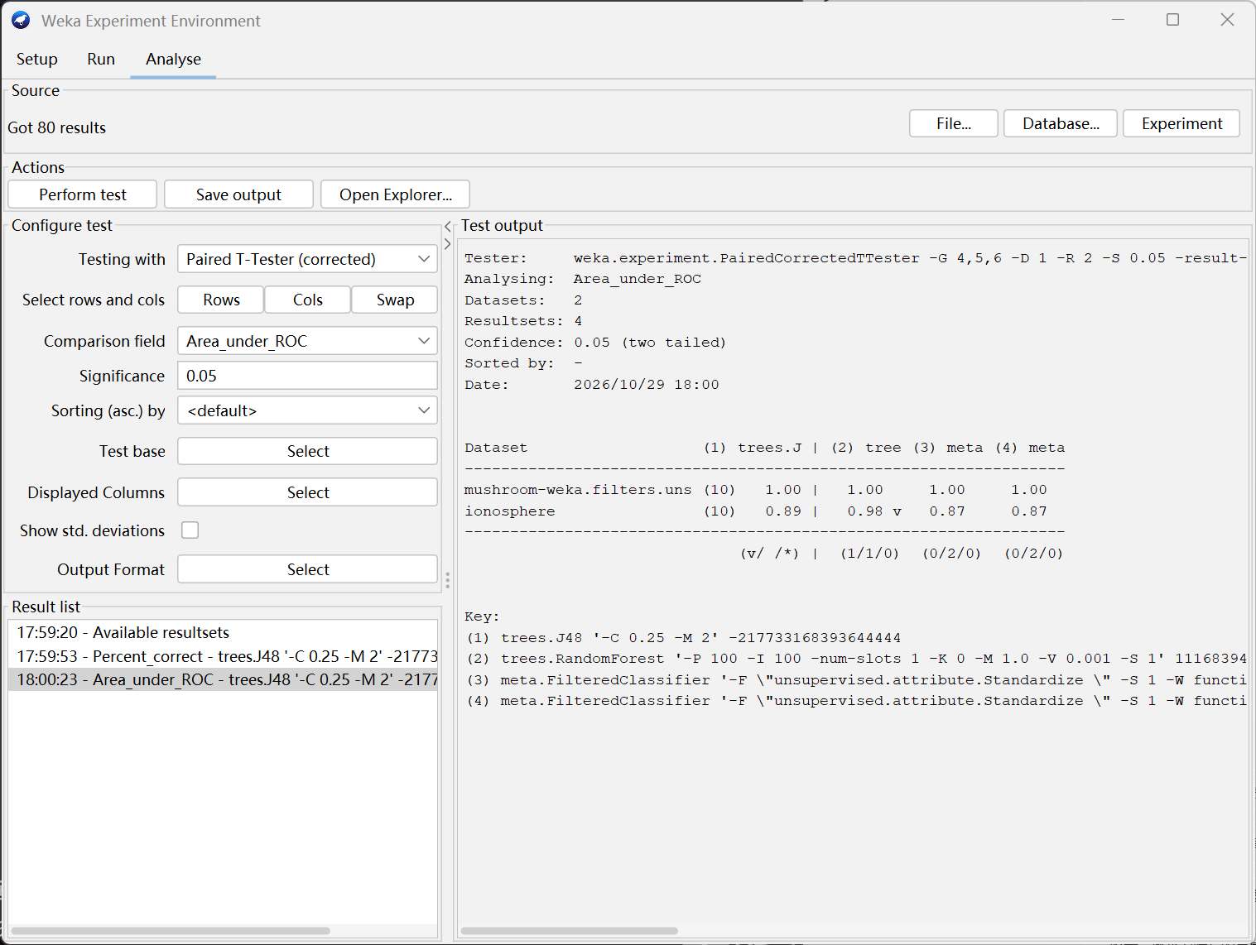
Model Comparison & Significance
/ PAIRED CORRECTED T-TEST, 0.05
What the test shows
Accuracy: no significant gap
All classifiers return 0/2/0 against J48, so the accuracy differences are not statistically significant.
AUC: RandomForest is significant
RF records 1/1/0 and is significantly better than J48 on ROC-AUC.
Careful wording
"Highest observed" is not the same as "significantly best"; significance is confirmed only for RF's AUC.
Weka Experimenter output: ROC-AUC across the ten folds

Slide 5
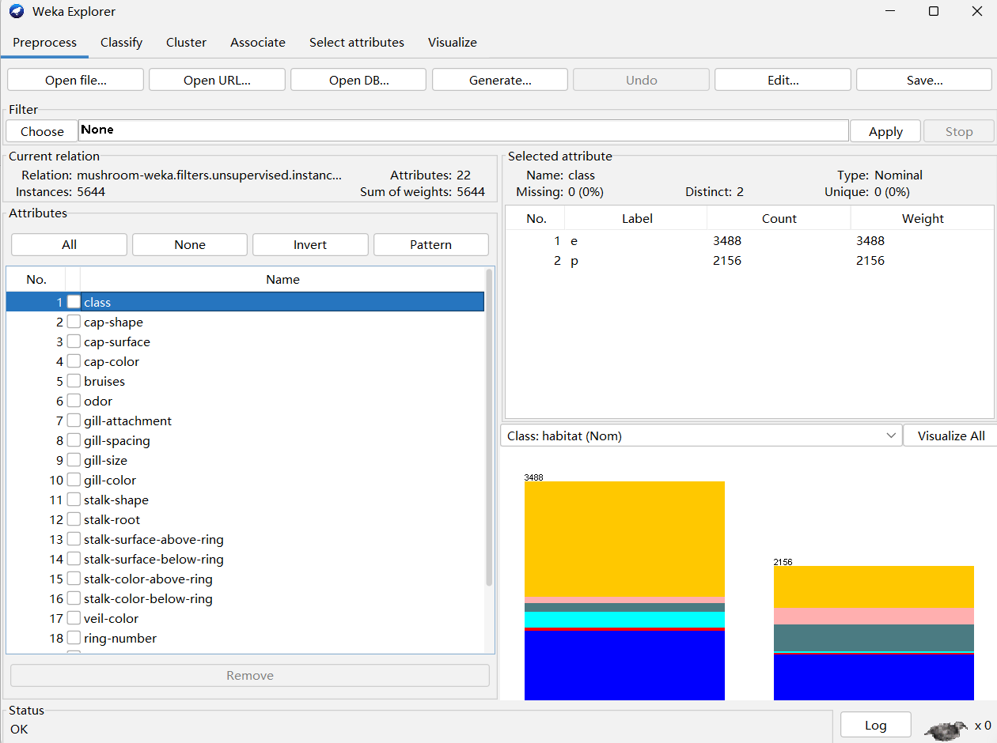
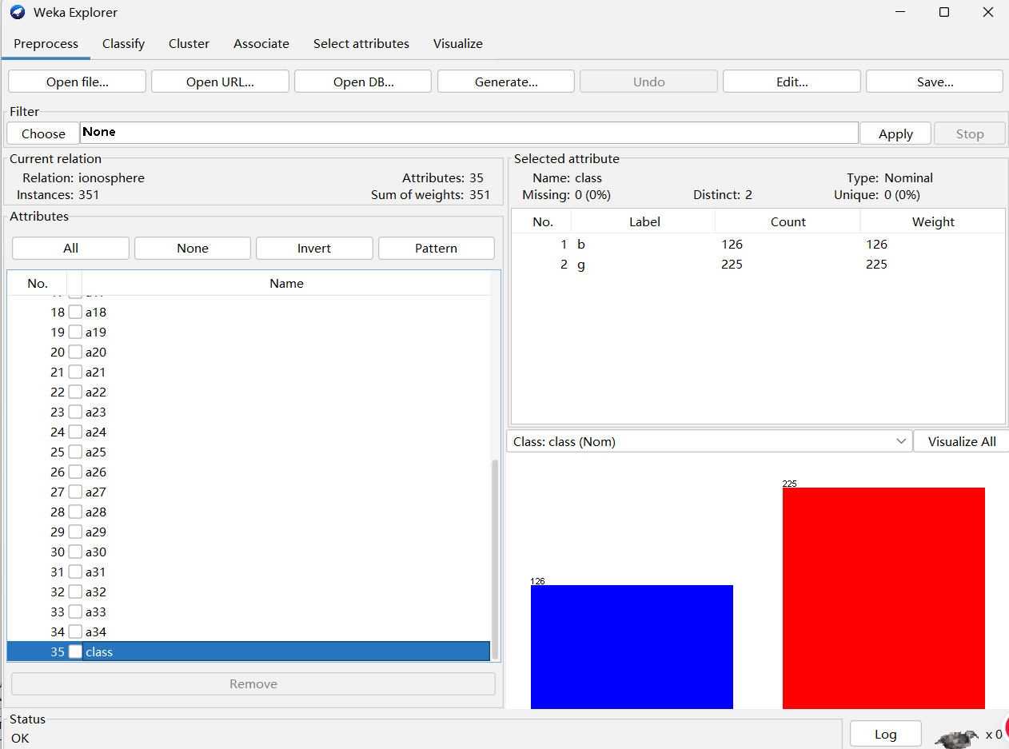
Cross-Dataset Comparison
/ MUSHROOM vs IONOSPHERE
Mushroom: 5,644 instances, 22 attributes
Ionosphere: 351 instances, 35 attributes
Mushroom hits a metric ceiling (all 100%), while Ionosphere differentiates the models. They differ in scale, attribute type, sample retention and parameters, so cross-dataset gaps cannot be attributed to any single factor.

Slide 6
Key Findings
/ SUMMARY & TAKEAWAYS
RandomForest leads on Ionosphere
Highest accuracy (92.88%) and a significantly higher ROC-AUC (0.98).
Mushroom is a perfect tie
All four classifiers reach 100% accuracy and AUC 1.00, so we report a tie rather than ranking them.
Added complexity is not always useful
Neither feature selection nor more trees gave a stable improvement.
Ensembles pay off on noisy data
The ensemble benefit appears only on the noisier, continuous dataset, not on the already-separable nominal one.

